Slide 1
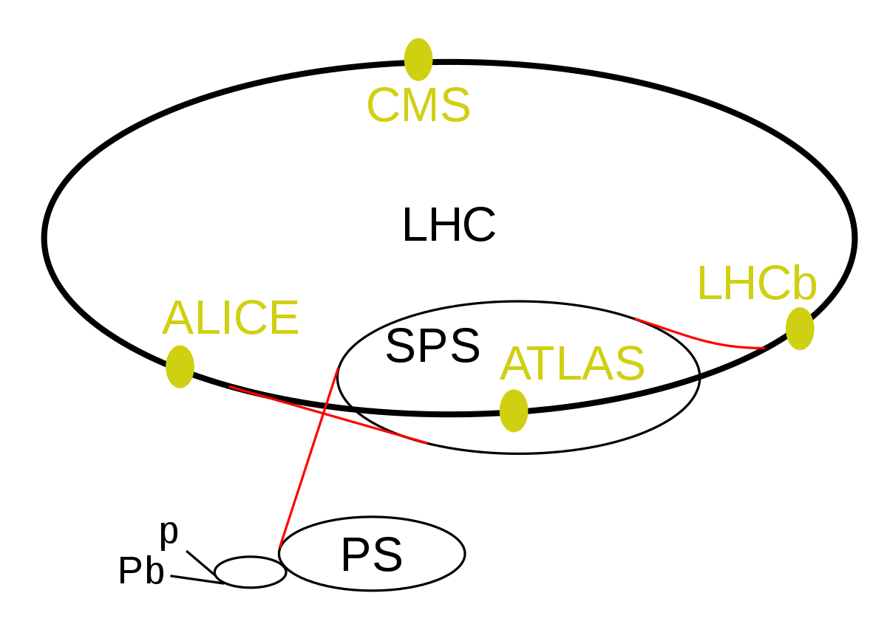

The Search for Axion Like Particles (ALPs) in B Meson Decays at the LHCb
Subrahmanya “Sai” Pemmaraju (supervised by Prof. Ulrik Egede) 17/04/2023
Notes:
Introduce self + supervisor, subject of talk, mention of physics beyond the SM,
Emphasise use of natural units for energies, masses and momenta measured
- Mention Large Hadron Collider b detector

Slide 2
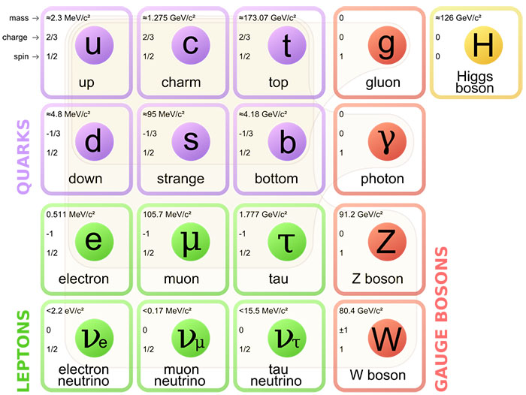
Standard Model Overview
Four fundamental forces in nature: strong, weak, electromagnetic (EM) and gravitational, each mediated by gauge bosons (of integer quantum spin)
Fermions = make up all matter (spin ½ particles)
Standard Model = (Almost) comprehensive description of the particles that exist in nature and the interactions between them
Image Source: https://www.abc.net.au/news/science/2017-07-15/the-standard-model-of-particle-physics-explained/7670338
Notes:
SM is a model that describes fundamental constituents of nature and the forces acting between them
Four fundamental forces in nature: strong, weak, EM and gravitational
Each are mediated by gauge bosons (having integer quantum spin)
Fermions = make up all matter (spin 1/2 particles)
SM = incomplete. There are many aspects observed or theorised that are not accounted for by the model

Slide 3

Limitations of the Standard Model
Does not describe gravitational force (no “graviton”)
Does not describe the nature of dark matter
CP Violation is not observed experimentally in the strong force, despite being theoretically allowed (Strong CP Problem)
Notes:
No mention of gravitational force in SM
Dark matter and dark energy are not described by this
A phenomenon known as CP violation is not experimentally observed in the strong force, despite being theoretically allowed (forms the basis of the strong CP problem). Foundation for introduction of ALPs

Slide 4
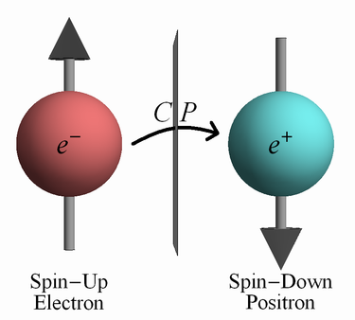
CP Violation
CP = symmetry which comprises of the charge conjugation (C), and parity (P) transformations
CP Violation = explanation for abundance of matter over antimatter in the Universe
CP symmetry is preserved in EM interactions and violated by weak interactions (Cronin & Fitch, 1964)
Image Source: http://www.timeone.ca/glossary/cp-symmetry/
Notes:
Symmetry = invariance of physical system under transformation (e.g. soccer ball is symmetric under rotation)
Particular symmetry of interest is CP symmetry, composed of charge conjugation (C) and parity (P) operations
Charge conjugation = swap particles for antiparticles
Parity = inversion of spatial coordinates (ilk mirror image)
CP symmetry = preserved in EM interactions and violated in weak interactions (e.g. Cronin and Fitch’s study of neutral kaon decay in 1964)

Slide 5
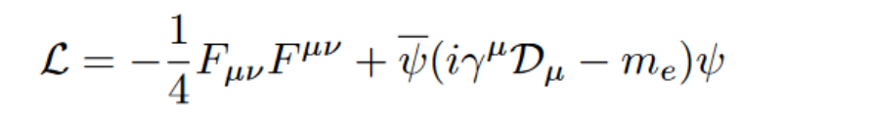

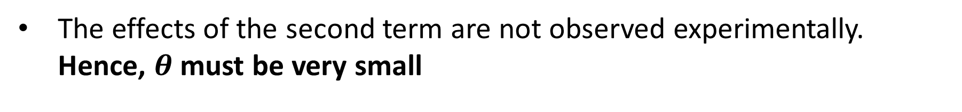
The Strong CP Problem
CP violation is theoretically permitted in the strong force (QCD) but there is no experimental evidence of this
QED Lagrangian (electromagnetism):
T
Consider the QCD (strong) Lagrangian written in the following form:
The effects of the second term are not observed experimentally. Hence, $θ$ must be very small
D.Tong, Lectures in Quantum Field Theory: https://www.damtp.cam.ac.uk/user/tong/qft/one.pdf
C.T. Chan, On the Symmetry Constraints of CP Violations in QCD: arxiv:hep-ph/9704427
Notes:
- Lagrangian = functional from which equations of motion of a system can be derived
F = EM field strength tensor. Equivalent term is present in the QCD Lagrangian involving the gluonic FST
Theta is CP violating, and we do not see the effects of the term involving it. Hence, conclude that it must be very small

Slide 6

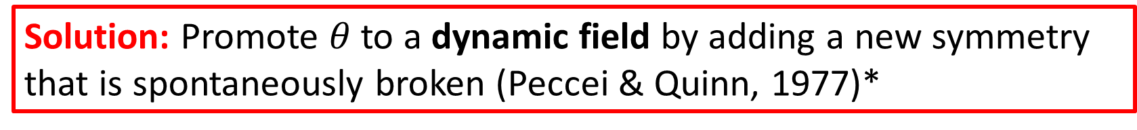
The Strong CP Problem and its Resolution
Experimental measurements of neutron EDM => $\left|θ\right|<{10}^{−10}$
Spontaneous breaking of this PQ symmetry introduces a new pseudoscalar (spin 0 and odd parity) particle known as the (QCD) axion. (No experimental evidence of this)
Solution: Promote $θ$to a dynamic field by adding a new symmetry that is spontaneously broken (Peccei & Quinn, 1977)*
*D.Tong, Lectures in Quantum Field Theory: https://www.damtp.cam.ac.uk/user/tong/qft/
Notes:
Absence of experimental evidence of CP violation => angular terms are close to 0
Experimental measurements of neutron EDM help constrain the value of these terms to below 10^-10 (fine tuning problem)
Can promote theta to a dynamic field by introducing a new symmetry that is spontaneously broken (Peccei and Quinn, 1977)
Theta is a field => it has a potential and excitations in this potential will produce new particles
New particle = pseudoscalar (spin 0 and odd parity) as known as the axion (NO EXPERIMENTAL EVIDENCE OF THIS, AND THIS HAS BEEN RULED OUT)
Axion will sit at the bottom of its field potential, thereby leading to CP violating parameters being equal to 0 w/o fine tuning

Slide 7

Axion Like Particles (ALPs)
Spontaneous breaking of an approximate symmetry (not PQ) can also generate other axion-like particles (ALPs).
Masses and couplings to photons are independent for ALPs and are therefore far less constrained
Couple predominantly to pairs of gauge bosons (e.g. $gg, γγ, ZZ, γZ, W^{±}$etc.) depending on the model being considered*
*Ringwald (2014) Axions and Axion-Like Particles: https://arxiv.org/pdf/1407.0546.pdf
** Isern et al. (2018) Axions and the Cooling of White Dwarf Stars https://arxiv.org/pdf/0806.2807.pdf
Notes:
SB of approximate symmetry (NOT PQ symmetry) can generate ALPs (they are similar to axions)
Masses and couplings to photons are independent for ALPs, whereas they vary inversely in the case of axions
Couple predominantly to pairs of gauge bosons, depending on model being considered
Hypothetical, feebly interacting pcle => Candidate for DM
Helps solve various astrophysical puzzles (e.g. anomalies in energy loss of white dwarf stars)**

Slide 8
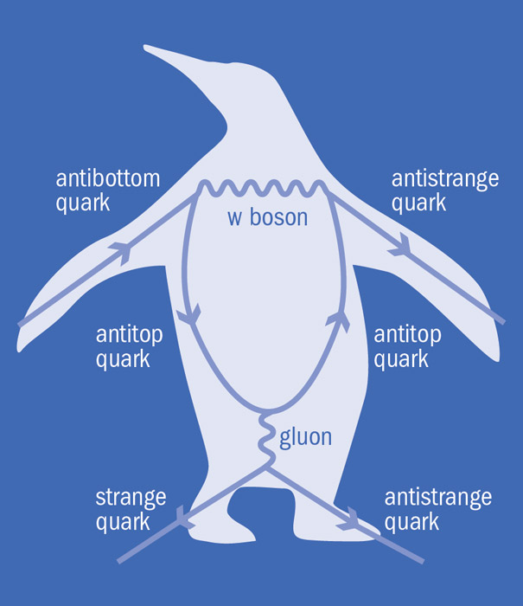
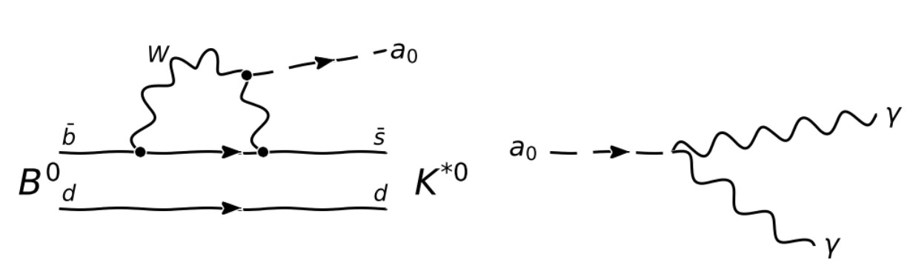


The $B^{0}→K^{∗}a_{0}, a_{0}→γγ$ Decay
Consider model where ALP couples to weak gauge bosons $W^{±}$, and gives rise to observable signatures (zero coupling with gluons)
Promising decay channel to examine at LHCb for this: $B^{0}→K^{∗}a_{0}, a_{0}→γγ$
(R) Image Source: https://cerncourier.com/a/chasing-new-physics-with-electroweak-penguins/
Notes:
Promising decay channel to search for ALPs at LHCb is $B→K^{∗0}a_{0}, a_{0}→γγ$, since this gives rise to observable signatures and is easier to analyse in the LHCb
Flavour Changing Neutral Current Decay
Also an electroweak penguin decay (diagram looks like a penguin)

Slide 9
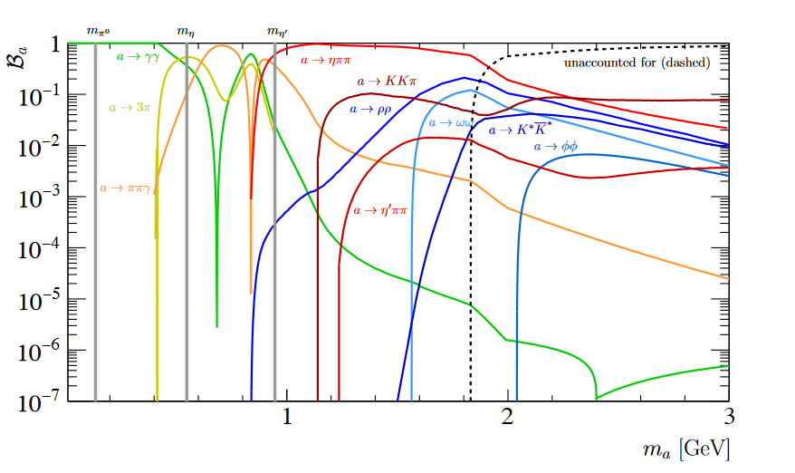
Plot of ALP Branching Fraction vs ALP Mass
Source: Daniel Aloni, Yotam Soreq, and Mike Williams Phys. Rev. Lett. 123, 031803 – Published 19 July 2019
Notes:
Have to be aware of BR of other decay modes of ALPs (only considering decay for two photons in initial analysis)
Further constraints may be imposed on the masses and coupling strengths of this
Whether or not this depends on model being considered is still being investigated

Slide 10
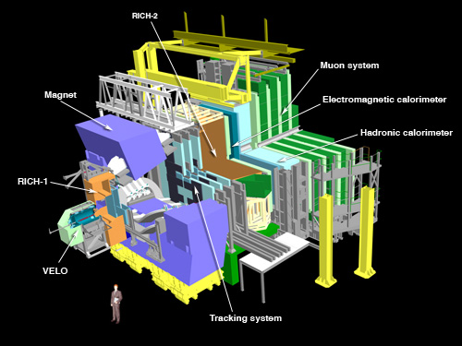
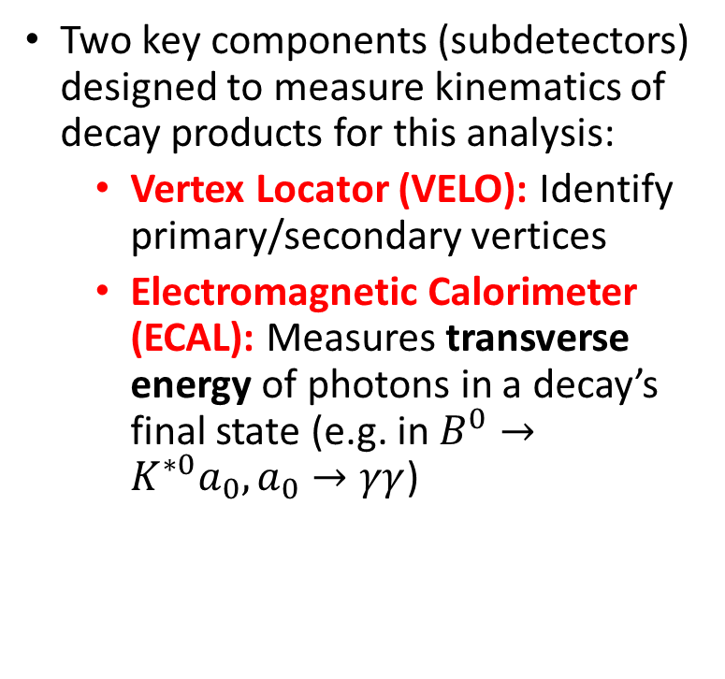
LHCb Detector
Two key components (subdetectors) designed to measure kinematics of decay products for this analysis:
Vertex Locator (VELO): Identify primary/secondary vertices
Electromagnetic Calorimeter (ECAL): Measures transverse energy of photons in a decay’s final state (e.g. in $B^{0}→K^{∗0}a_{0}, a_{0}→γγ$)
Image Source: https://www.lhc-closer.es/taking_a_closer_look_at_lhc/0.lhcb
Notes:
- Specialised experiment that is part of the LHC in Switzerland, designed to investigate CP violation in particles involving the $b$-quark through collisions of opposing proton beams at high energies
- $pp$ collision produces numerous unstable particles, many of which will subsequently decay into lighter, more stable particles
Two key components (subdetectors) designed to measure kinematics of decay products for this analysis:
Vertex Locator (VELO): Identify primary/secondary vertices (enables decay length of B0 to be measured and identifies the vertices of the particles’ origins)
EM CALORIMETER (ECAL): Measures transverse energy of $e^{−}, γ$, and $π^{0}$ for decays with a photon in the final state (e.g. in $B^{0}→K^{∗0}a_{0}, a_{0}→γγ$ decay channel

Slide 11









The LHCb Detector (contd.)
$pp$ collision produces numerous unstable particles, many of which will subsequently decay into lighter, more stable particles
Secondary vertex
pp interaction (primary vertex)
$$K^{+}$$
$$K^{∗0}$$
$$a_{0}$$
$$π^{−}$$
$$B^{0}$$
$$L∼10 mm$$
$$γ$$
$$γ$$
Notes:
$pp$ collision produces numerous unstable particles, many of which will subsequently decay into lighter, more stable particles
Primary and secondary vertices (indicated in green) = identified by VELO
ECAL measures energy deposited onto it by the two photons (highlighted in yellow). Seek signal in invariant mass spectrum of $γγ$
Assumed that $a_{0}$ decays straight away => kaon, pion and photons are produced from the secondary vertex

Slide 12
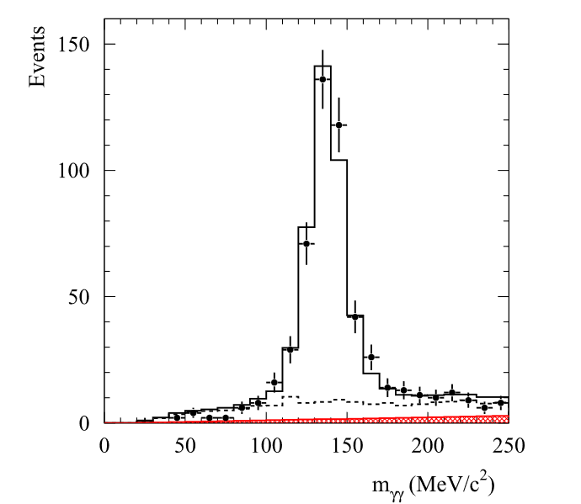
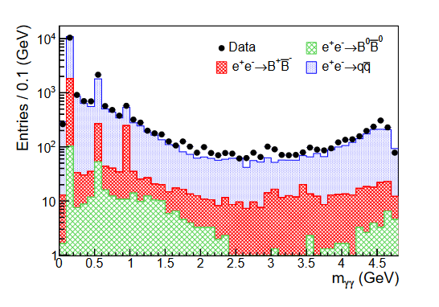
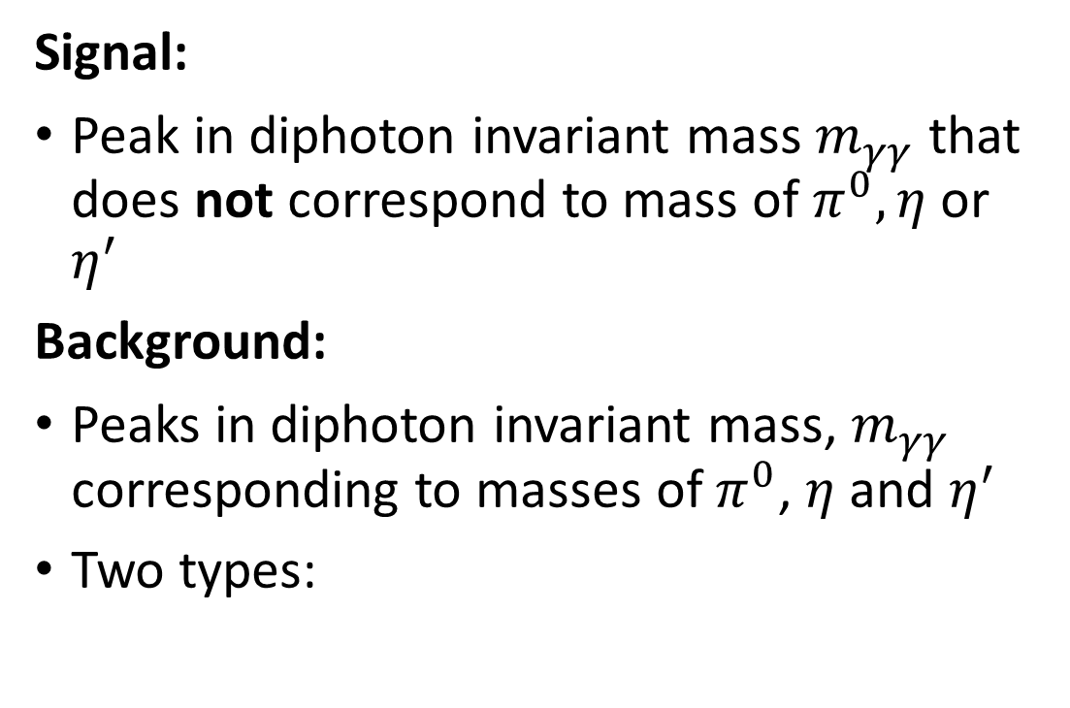
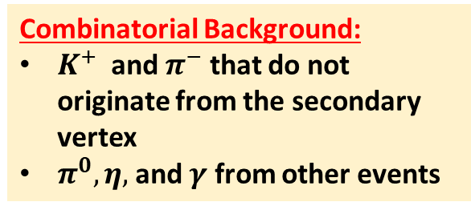

Signal and Background
Signal:
Peak in diphoton invariant mass $m_{γγ}$ that does not correspond to mass of $π^{0}, η$ or $η^{′}$
Background:
Peaks in diphoton invariant mass, $m_{γγ}$ corresponding to masses of $π^{0}$, $η$ and $η^{′}$
Two types:
https://doi.org/10.1140/epjc/s10052-020-08719-9
Irreducible Background:
$B^{0}→, K^{∗0}π^{0}, π^{0}→γγ$
$B^{0}→K^{∗0}η, η→γγ$
$B^{0}→K^{∗0}η^{′}, η^{′}→γγ$
Combinatorial Background:
$K^{+}$ and $π^{−}$ that do not originate from the secondary vertex
$π^{0}, η,$ and $γ$ from other events
Notes:
Signal = Peak in diphoton invariant mass $m_{γγ}$ that does not correspond to mass of $π^{0}, η$ or $η^{′}$
Right hand image = study from CMS detector on the $H→γγ$ decay mode (example of type of signal we are looking for)
Background = Peaks in diphoton invariant mass $m_{γγ }$that correspond to the mass of $π^{0}$, $η$ and $η′$

Slide 13

Strategy: Search for ALPs at LHCb
ALPs produced in $B$-meson decays have a maximal mass of
$$m_{a_{0}}=m_{B^{0}}−m_{K^{∗}}=5279.26−493.68 MeV=4785.58 MeV$$
The BABAR Collaboration: Search for Axion Like Particles in B Meson Decays: arxiv:111.01800
Notes:
Max mass of ALPs being produced here is 4785.58 MeV (since rest mass of B0 is 5 GeV)
Explain plot in further detail (different coloured regions = different meson-anti-meson pairs produced from e+ e- collisions)
LHCb has potential to do better than these measurements as there are more B mesons produced here in comparison to B-factory experiments

Slide 14
Analysis Steps
0. Explore the range of limits that can be imposed on the branching fraction of decay mode to see if analysis is viable
1. Event selection (inspect features of MC simulated data for the signal, and real data for the background and attempt to distinguish signal from background)
2. Check optimised event selection against a real data sample to see if MC simulation models the data
3. Perform a fit to extract the signal yield (if it appears to exist in the data)
4. Estimate systematic errors
Notes:
0. Explore the range of limits that can be imposed on the branching fraction of decay mode to see if analysis is viable
1. Event selection (inspect features of MC simulated data for the signal, and real data for the background and attempt to distinguish signal from background)
- Proceed through remaining steps.

Slide 15
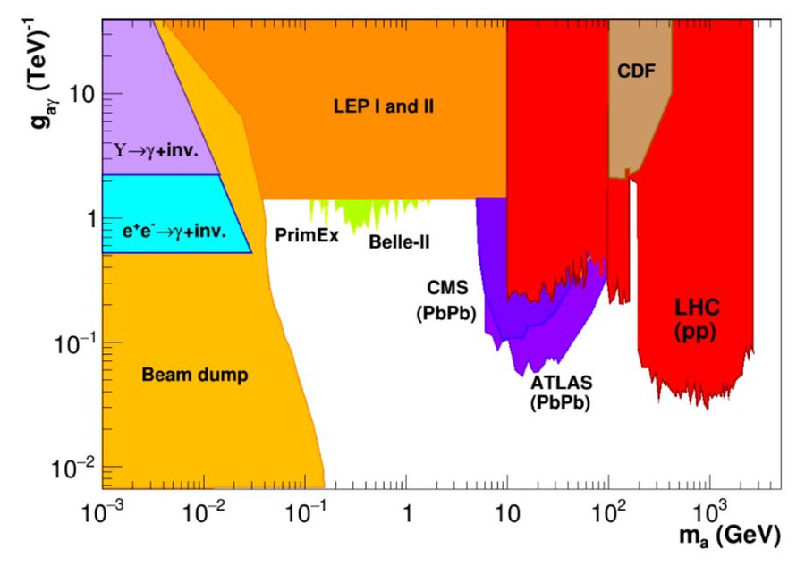
Preliminary Analysis Steps
Explore the range of limits that can be imposed on the branching fraction of decay mode to see if analysis is viable (Step 0)
Relating the branching ratio to the mass and coupling strength of the ALP to photons
Comparing the limits set on the mass and coupling strength to those in existing literature
 | arXiv:2102.08971
D. d’Enterria, Collider constraints on axion-like particles:
Notes:
Explore the range of limits that can be imposed on the branching fraction of decay mode to see if analysis is viable
Relating the branching ratio estimate to the mass and coupling strength of the ALP to photons
Comparing the limits set on the mass and coupling strength to those in existing literature (LH plot: we are trying to exclude more of the white region if not find the ALP itself). ATLAS has PbPb collisions for the same and has set different limits to what we can.
LHCb => Can try and exclude regions in the low-mass (below 5 GeV) range

Slide 16
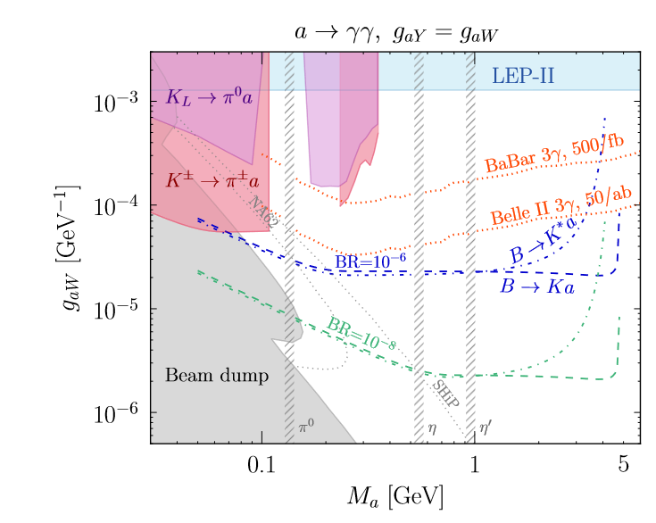
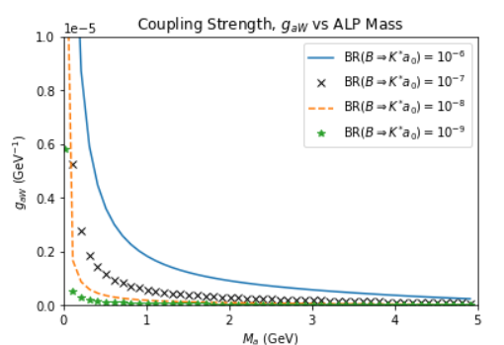
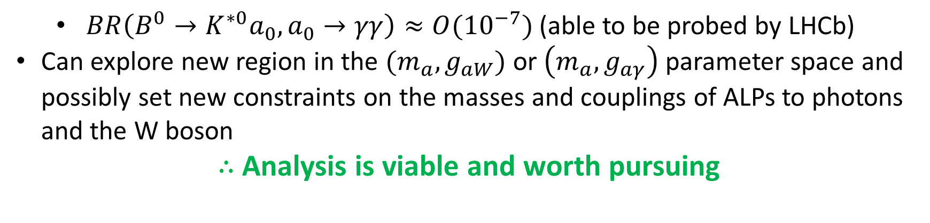
Preliminary Analysis Outcomes
$BR\left(B^{0}→K^{∗0}a_{0}, a_{0}→γγ\right)≈{O(10}^{−7})$ (able to be probed by LHCb)
Can explore new region in the $(m_{a}, g_{aW})$ or $\left(m_{a}, g_{aγ}\right)$ parameter space and possibly set new constraints on the masses and couplings of ALPs to photons and the W boson
$∴$ Analysis is viable and worth pursuing
Middle plot sourced from: E. Izaguirre, T. Lin, and B. Shuve, A new flavor of searches for axion-like particles, 2016. arXiv:1611.09355
Notes:
- Plot of the Coupling strength of ALP to the W boson as a function of the ALP mass (at a fixed branching ratio)
Estimated order of BR at which our analysis is viable (10^-7) by comparison to measurements made of a decay mode of similar topology
Can explore new region in the $(m_{a}, g_{aW})$ or $\left(m_{a}, g_{aγ}\right)$ parameter space and possibly set new constraints on the masses and couplings of ALPs to photons and the W-boson
Left plot = same as the one earlier
Middle plot = ALP mass (GeV) vs coupling strength to W bosons (GeV^-1)
Right plot = my recreation of middle plot with BR = 10^-7 line included (black crosses)
Middle and right plots assume that BR(a_0 to two photons) = 1 (not always true, as we shall see)

Slide 17
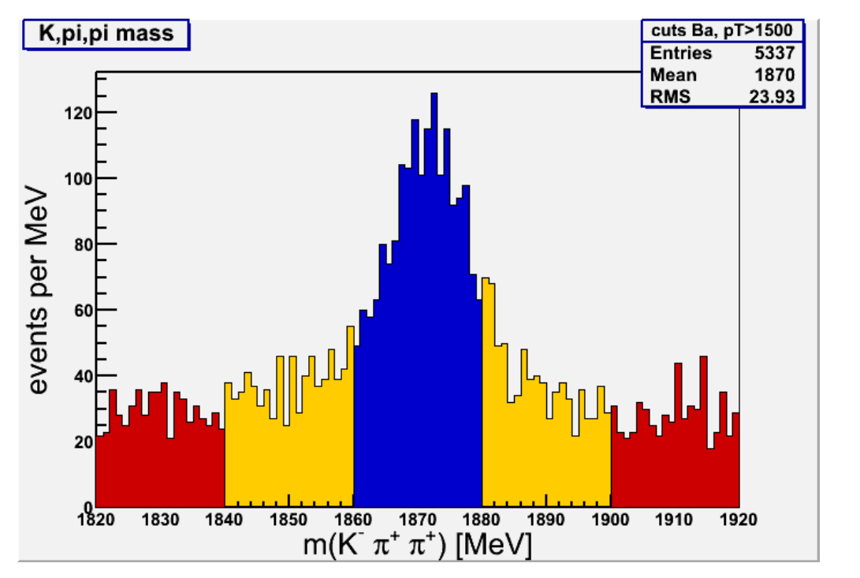
Future Work: Event Selection
Inspect full-detector MC simulated data to understand characteristics of the signal
Use real data from high mass sideband to model background and inspect features thereof
Develop event selection criteria that is able to distinguish the signal from the background based on these features (Work in Progress)
Nominal signal region
Low mass sideband
High mass sideband
Image Source: https://goofit.gitlab.io/root-tutorial/tutorial-3.html
Notes:
Inspect full-detector MC simulated data to understand characteristics of the signal
Use real data from high mass sideband to model background and inspect features thereof. Right hand side = example of high mass sideband for different combination to decay of interest
Develop event selection criteria that is able to distinguish the signal from the background based on these features (Work in Progress)

Slide 18

Addendum: Flavour Changing Neutral Currents (FCNC)
$\overline{b}(b)→\overline{s}(s)$ quark transition forbidden at tree level in SM
Neutral $Z^{0}$ cannot change quark flavour in SM
Can add “loops” into Feynman diagram and allow for this (decay that proceeds will be suppressed)
$B→K^{∗}a_{0}, a_{0}→γγ$ proceeds at one-loop level (it can still occur, but the probability is much lower)

Slide 19
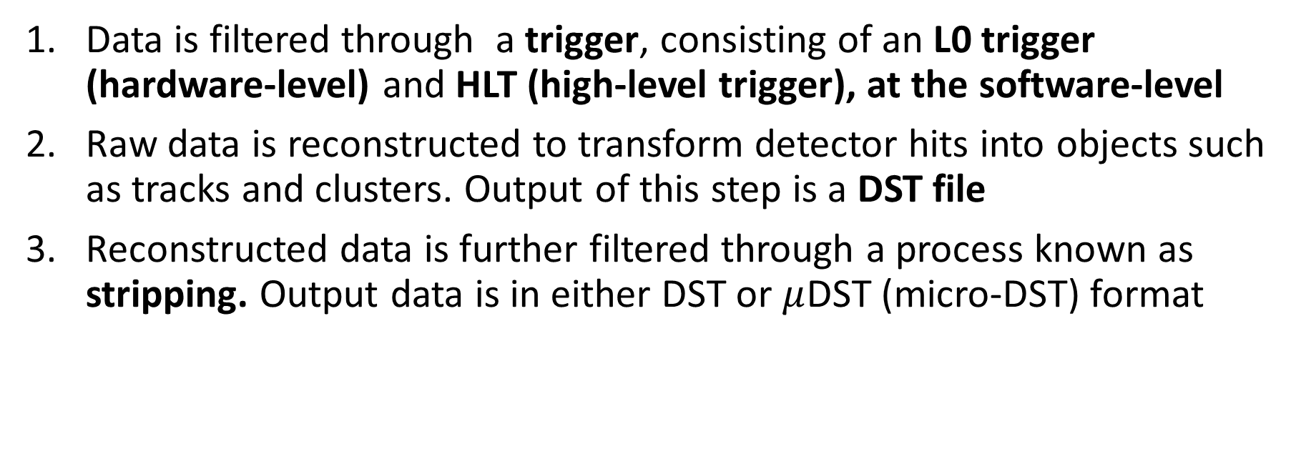
Addendum: LHCb Data Flow
Data is filtered through a trigger, consisting of an L0 trigger (hardware-level) and HLT (high-level trigger), at the software-level
Raw data is reconstructed to transform detector hits into objects such as tracks and clusters. Output of this step is a DST file
Reconstructed data is further filtered through a process known as stripping. Output data is in either DST or $μ$DST (micro-DST) format
Note: A large number of Monte Carlo (MC) simulated events are also produced that are also processed in a similar way to real data. $pp$ collisions and the detector response are simulated in this process
Source: LHCb Starterkit: https://lhcb.github.io/starterkit-lessons/first-analysis-steps/README.html

Slide 20
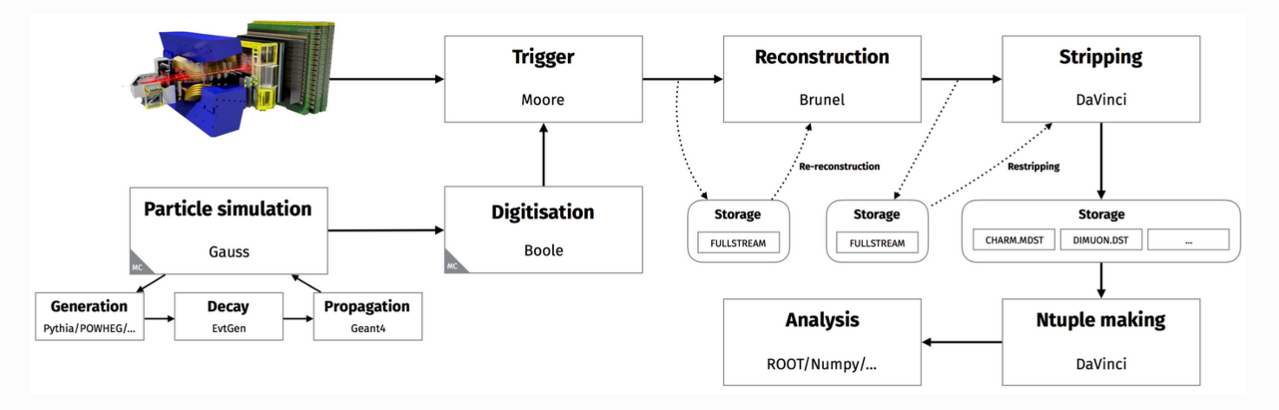




Addendum: LHCb Simulation Framework
Applications used for simulation framework (e.g. Gauss, DaVinci, etc.) are predominantly implemented in Python and/or C++
All MC simulations used so far are generator level simulations (i.e. only Gauss, and DaVinci steps are executed). Full simulation is time-consuming but more detailed

Slide 21
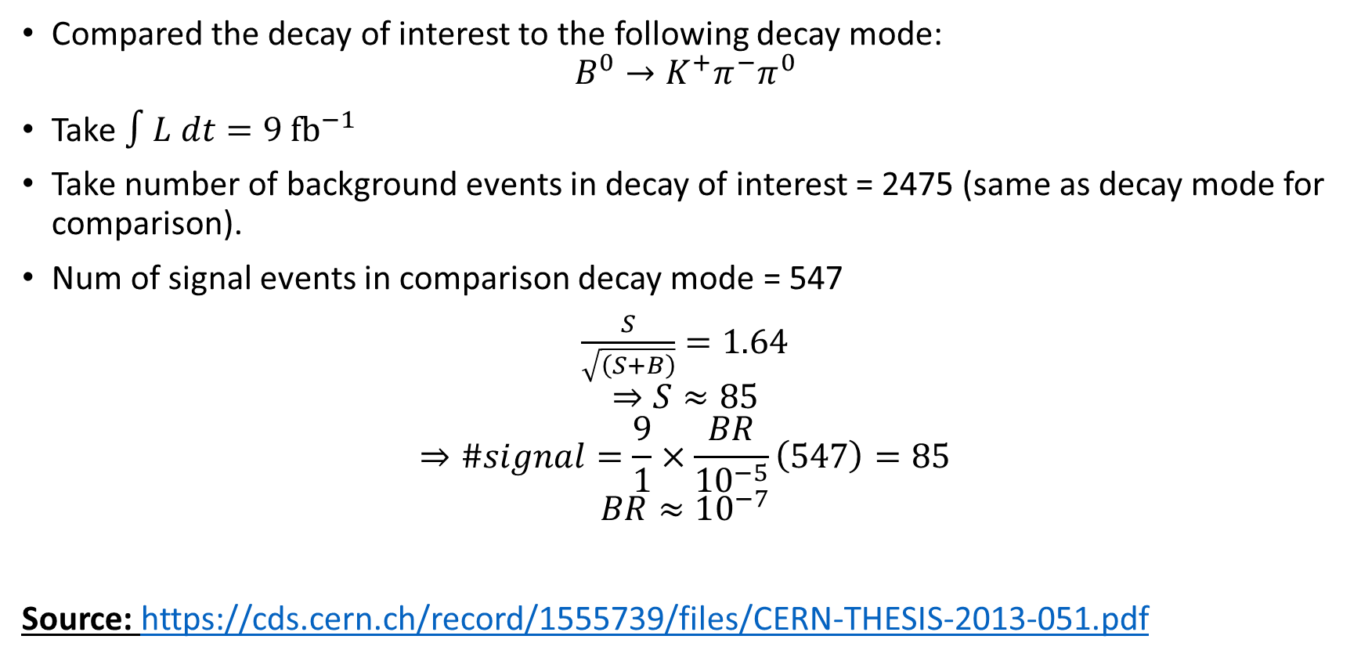
Addendum: Upper Limit on Branching Ratio
Compared the decay of interest to the following decay mode:
$$B^{0}→K^{+}π^{−}π^{0}$$
Take $∫L dt=9 {fb}^{−1}$
Take number of background events in decay of interest = 2475 (same as decay mode for comparison).
Num of signal events in comparison decay mode = 547
$\frac{S}{\sqrt{\left(S+B\right)}}=1.64$
$$⇒S≈85$$
$$⇒\#signal=\frac{9}{1}×\frac{BR}{10^{−5}}\left(547\right)=85$$
$$BR≈10^{−7}$$
Source: https://cds.cern.ch/record/1555739/files/CERN-THESIS-2013-051.pdf
Notes:
- Decay mode has a clear signal at $4×{10}^{−5}$ with 547 signal events and 2475 background events

Slide 22
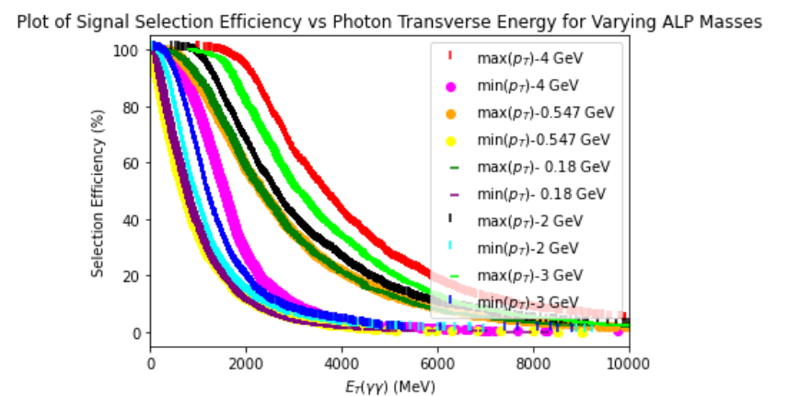
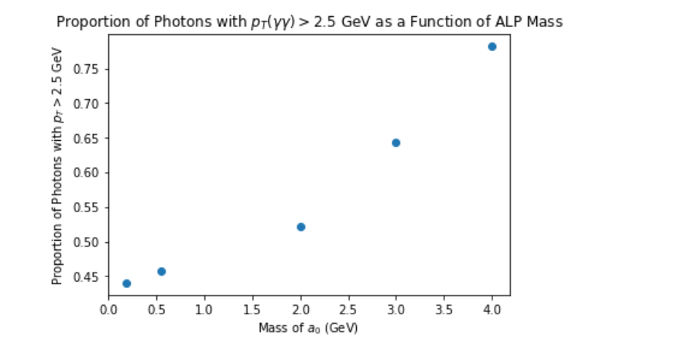
Addendum: L0 Trigger Efficiency Study
Detector data is filtered through a trigger, consisting of an L0 trigger (hardware-level) and HLT (high-level trigger), at the software-level
L0 trigger = selects events containing high energy photons, electrons, and hadrons
Performed L0 electromagnetic trigger efficiency study to understand how this varies with ALP mass
Notes:
Detector data is filtered through a trigger, consisting of an L0 trigger (hardware-level) and HLT (high-level trigger), at the software-level
L0 trigger = selects events containing high energy photons, electrons, and hadrons
Top plot = selection efficiency vs diphoton transverse energy for fixed ALP mass
Bottom = proportion of photon pairs exceeding trigger threshold of $p_{T}>$2.5 GeV as a function of ALP mass. Consistent with conservation of 4 momentum

